Slide 1
Evaluation of weather forecast with DL
A B M Abir Mahboob

Slide 2

Introduction

Slide 3
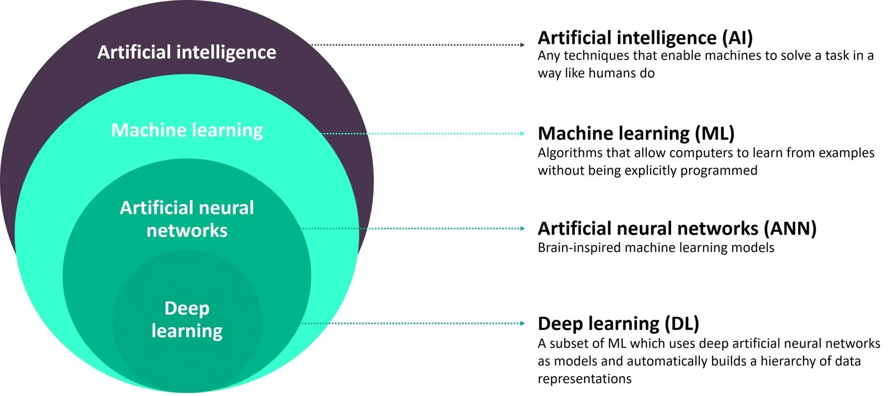
Deep Learning

Slide 4
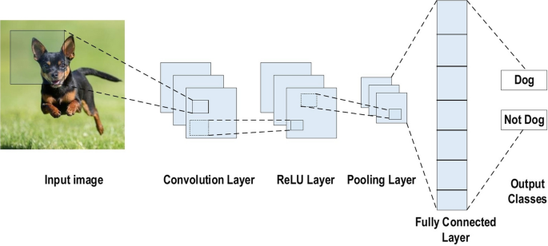
Convolutional Neural Network

Slide 5
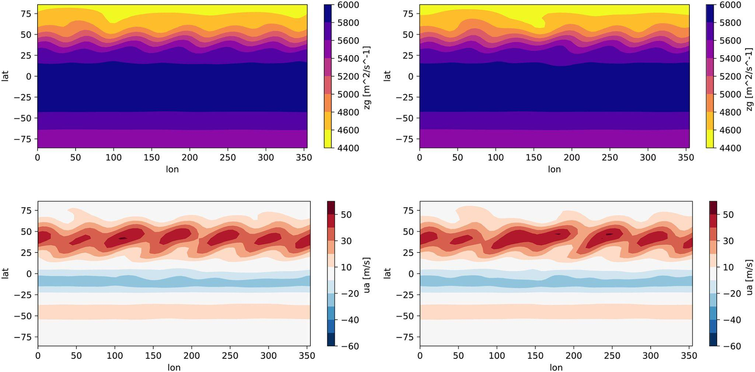
PUMA Method
10 vertical levels
A time step of 45 minutes
Horizontal resolution of T21 (about 625 km, 32 × 64 grid points)

Slide 6
Results

Slide 7
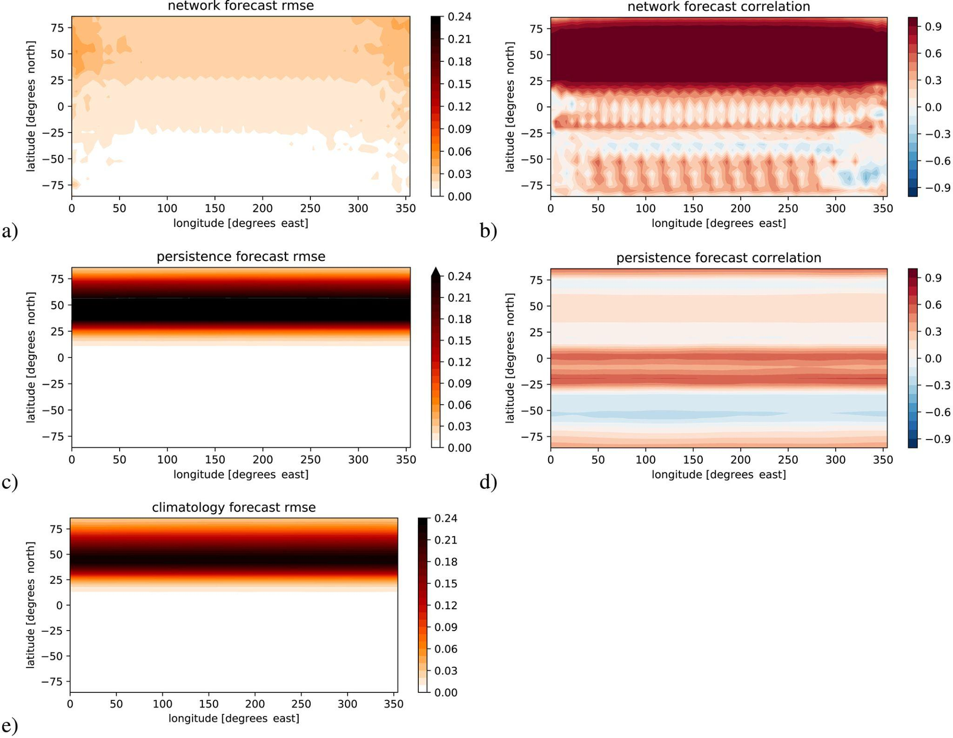
Weather Forecasting Mode

Slide 8
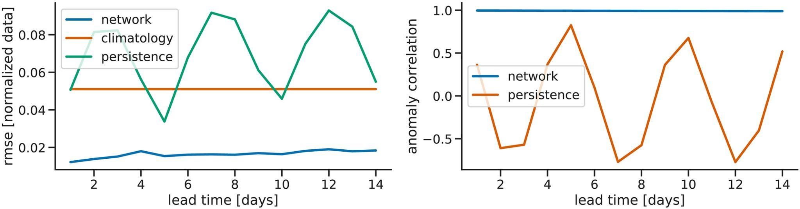
Weather Forecasting Mode

Slide 9
Climate
Mode

Slide 10
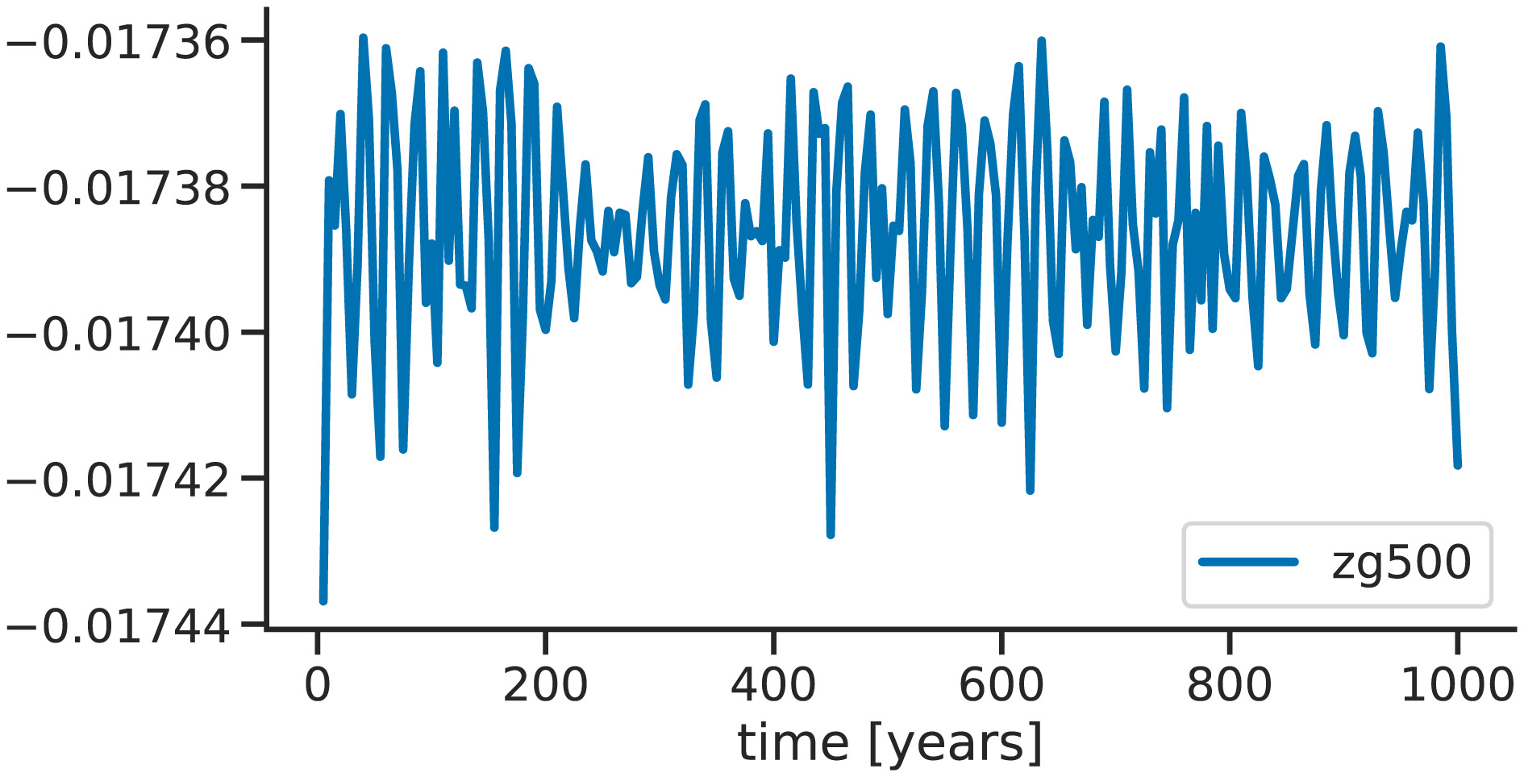
Climate
Mode

Slide 11
Conclusion

